Slide 1
Portfolio data science
Syahid arbi

Slide 2
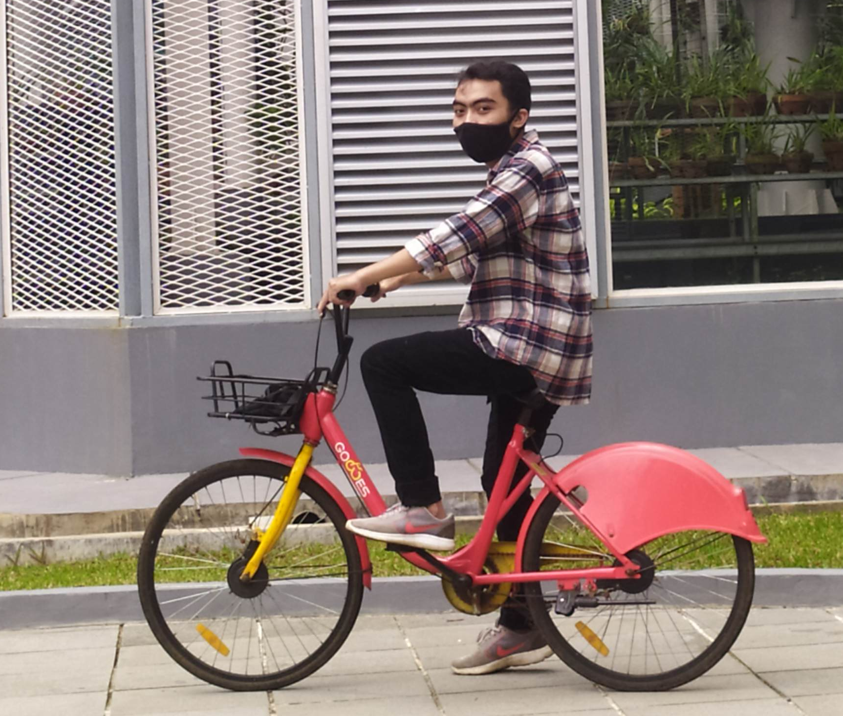
ABOUT ME
“A fishery graduate who is trying to shifting careers in the field of data processing and analysis. Disciplined, adaptable, good at problem solving and able to learn quickly. Interest in work that provides opportunities for analysis, observation, and in-depth exploration to solve problems. Have the ability in data analysis using several tools such as: Excel, PostgreSQL, python programming language and google data studio ”

Slide 3
Introduction
Housing in India varies from palaces of erstwhile maharajas to modern apartment buildings in big cities to tiny huts in far-flung villages. There has been tremendous growth in India's housing sector as incomes have risen. The Human Rights Measurement Initiative finds that India is doing 60.9% of what should be possible at its level of income for the right to housing.
Renting is an agreement where a payment is made for the temporary use of a good, service, or property owned by another. A gross lease is when the tenant pays a flat rental amount and the landlord pays for all property charges regularly incurred by the ownership. Renting can be an example of the sharing economy. Therefore here we try to create a machine learning model to predict the price of renting a house or apartment based on available data so that we can easily predict the rental price of a house/apartment.

Slide 4
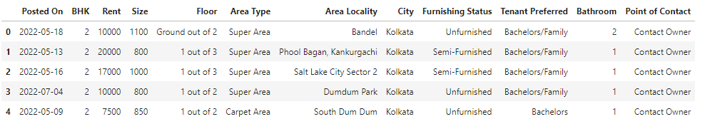
Dataset
Colums | Description
BHK | Number of Bedrooms, Hall, Kitchen
Rent | Rent of the Houses/Apartments/Flats.
Size | Size of the Houses/Apartments/Flats in Square Feet
Floor | Houses/Apartments/Flats situated in which Floor and Total Number of Floors (Example: Ground out of 2, 3 out of 5, etc.)
Area Type | Size of the Houses/Apartments/Flats calculated on either Super Area or Carpet Area or Build Area
Area Locality | Locality of the Houses/Apartments/Flats
City | City where the Houses/Apartments/Flats are Located
Furnishing Status | Furnishing Status of the Houses/Apartments/Flats, either it is Furnished or Semi-Furnished or Unfurnished
Tenant Preferred | Type of Tenant Preferred by the Owner or Agent
Bathroom | Number of Bathrooms
Point of Contact | Whom should you contact for more information regarding the Houses/Apartments/Flat

Slide 5


Data Overview
The steps taken for the data overview are:
Check data table
Check null value
Check data duplicate
Check data descriptive
Results
Data have 4746 rows and 12 columns
Columns rent is target
Data has no null value
Data has no duplicate value
Columns area locality can removed because to many unique value
Posted on can preprocessing into year and month
Columns floor can split into floor and total floor

Slide 6

Data Cleaning
Remove Area Locality because to many unique value there
Split data Posted_On to month_posted and save as integer (not split to year because year just have 1 unique value: 2022)
Split data Floor to floor and total floor, then save as integer
Handling outlier to reduce bias in the prediction results
Before data cleaning
After data cleaning

Slide 7

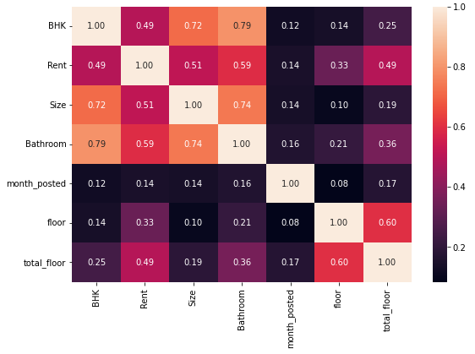
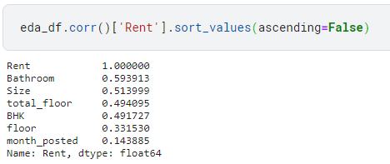
Exploratory data analysis
The correlation between numerical data and rent data from the highest is Bathroom, Total floor, Size, BHK, floor and month posted. Correlation value shows the magnitude of the influence of one data with other data, where the greater the correlation value, the greater the effect.

Slide 8
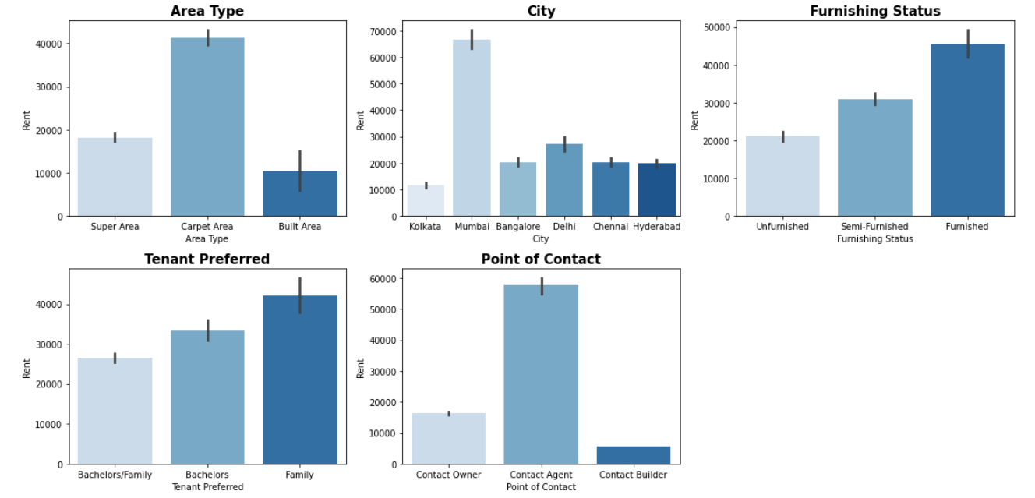
Exploratory data analysis
House/apartment with a carpet area type, the highest rental price compared to other types of areas
Mumbai is the city with the most expensive house/apartment rent prices compared to others
The house is divided into several furnishing statuses in order of the most expensive price, namely: furnishing, semi-furnishing, and unfurnishing.
The priority for the house is the family, the rent is more expensive.
rent price a house with a contact point at the agent has a more expensive value than others

Slide 9
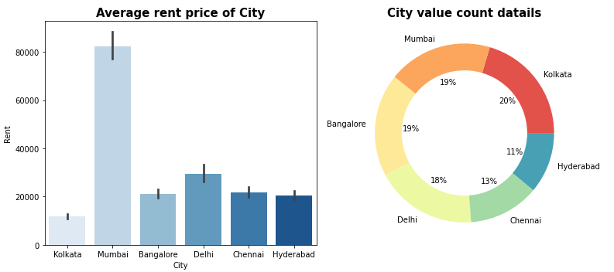
Exploratory data analysis
The average rental price for a house/apartment in Mumbai is more than 2-3 times higher than in other cities.
In contrast to the city of Mumbai, the city of Kolkata has an average rental price that is cheaper than the others

Slide 10
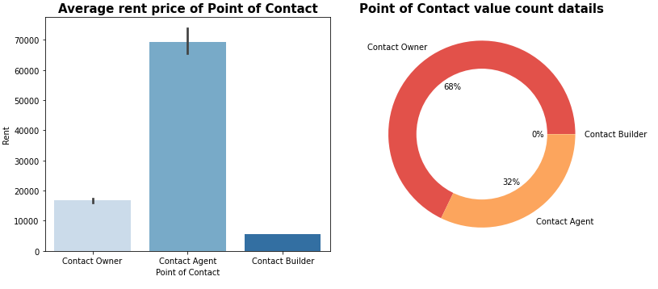
Exploratory data analysis
From the data, it is known that the agent can increase the rental price of the house/apartment up to 3 times the price given by the owner.
To get a cheaper house/apartment rental price, it's a good idea to look for the owner directly because quite a lot of houses are rented directly by the owner.

Slide 11


Model preparation
The steps taken for model preparation are:
Data Encoding
Describe Feature and Target
Split data train & test
Data scaling with
One hot encoding : Area Type, City, Tenant Preferred, Point
Label encoding : Furnishing Status
Feature : all data after preprocessing
Target : Rent
Test size : 0.3
Library : sklearn.model_selection import train_test_split
Library : sklearn.preprocessing import MinMaxScaler

Slide 12

Modeling
1
Predict data
Hyperparameter Tuning
4
5
Fit model
2
3
Fit final model after hyperparameter tuning
Predict data
model use: random forest regressor

Slide 13

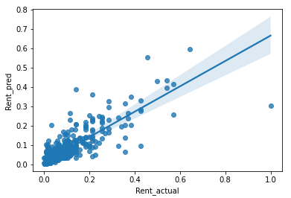
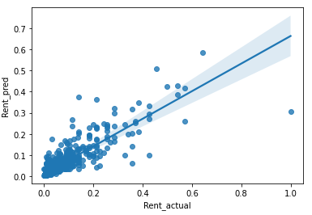


Model evaluation
Before HayperParameter Tuning
After HayperParameter Tuning

Slide 14

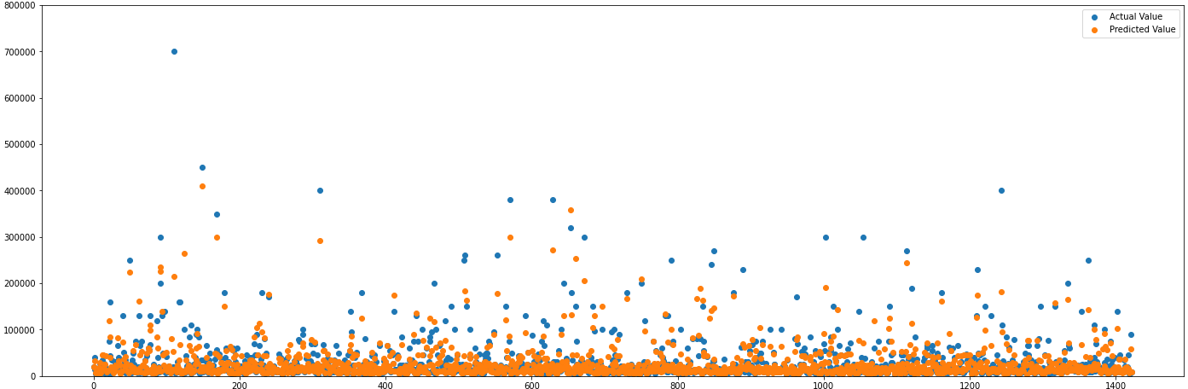
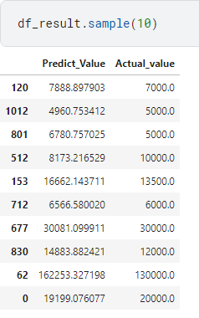
Result
The following is the result of the comparison between the actual value and the predictive value of the model created. With this model, it is hoped that it will make it easier for tenants or owners to determine the appropriate rental price so that no one is harmed.

Slide 15

Thanks for watching!!!
The full code can be seen here
Contact
No HP : 081383213154
Email : syahidarbi04@gmail.com
Linkedin : linkedin.com/in/syahid-arbi

